Slide 1
Publicis Sapient Logo

Slide 2


PATIENT REGISTRATION FORM
March 04, 2023

Slide 3

Patient Reservation System
March 04, 2024
Shaik Mohammed Afrid

Slide 4
agenda
Objective
Devops
Git and GitHub
Docker
Jenkins
Kubernetes
Ansible
Implementation
Output Screenshots

Slide 5
Objective
Design a Hospital Patient Reservation Application where we need to collect the program should allow users provide Full Name, Date of Birth, Gender, Social Security Number, Marital Status, Phone Number, Email ID.. This level aims to provide a foundational understanding of Nodejs and database connectivity using microservices architecture and deploy application to docker and automate the process continuous integration and deployment using Jenkins.

Slide 6
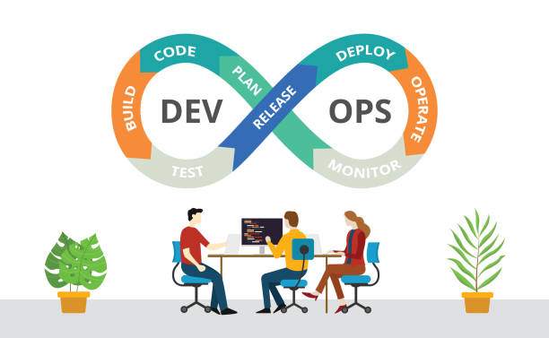
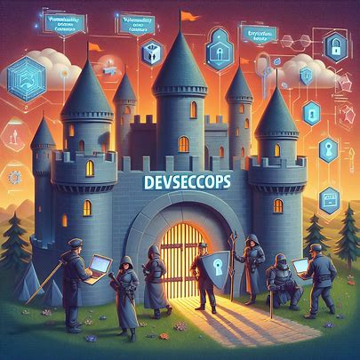
Devops
DevOps combines development and operations to increase the efficiency, speed, and security of software development and delivery compared to traditional processes. A nimbler software development lifecycle results in a competitive advantage for businesses and their customers.

Slide 7
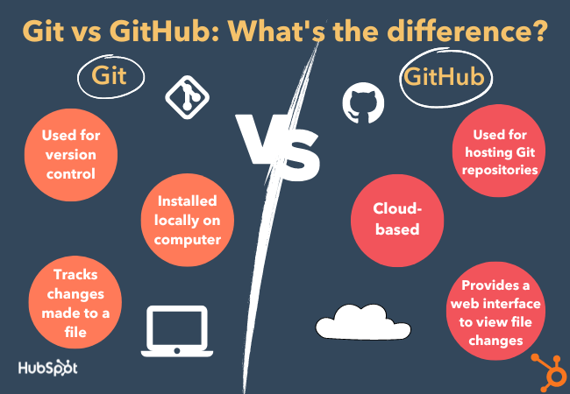
Git and GitHub

Slide 8
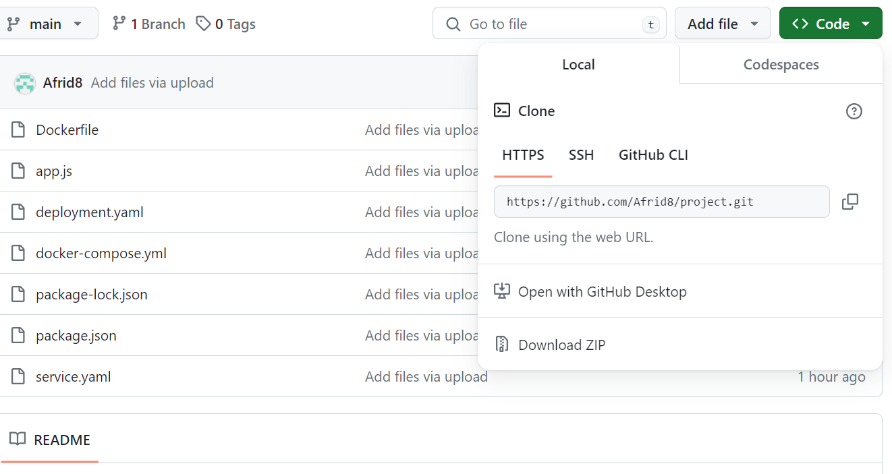
Git and GitHub

Slide 9

Docker
Docker is an open platform for developing, shipping, and running applications.
Docker allows you to separate your applications from your infrastructure so you can deliver software quickly. With Docker, you can manage your infrastructure in the same ways you manage your applications.

Slide 10
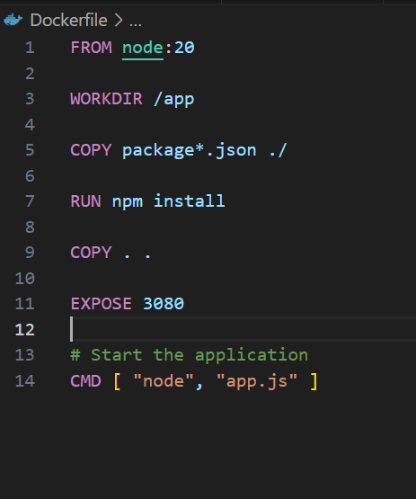
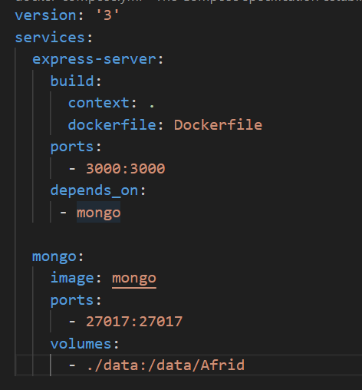
Docker

Slide 11
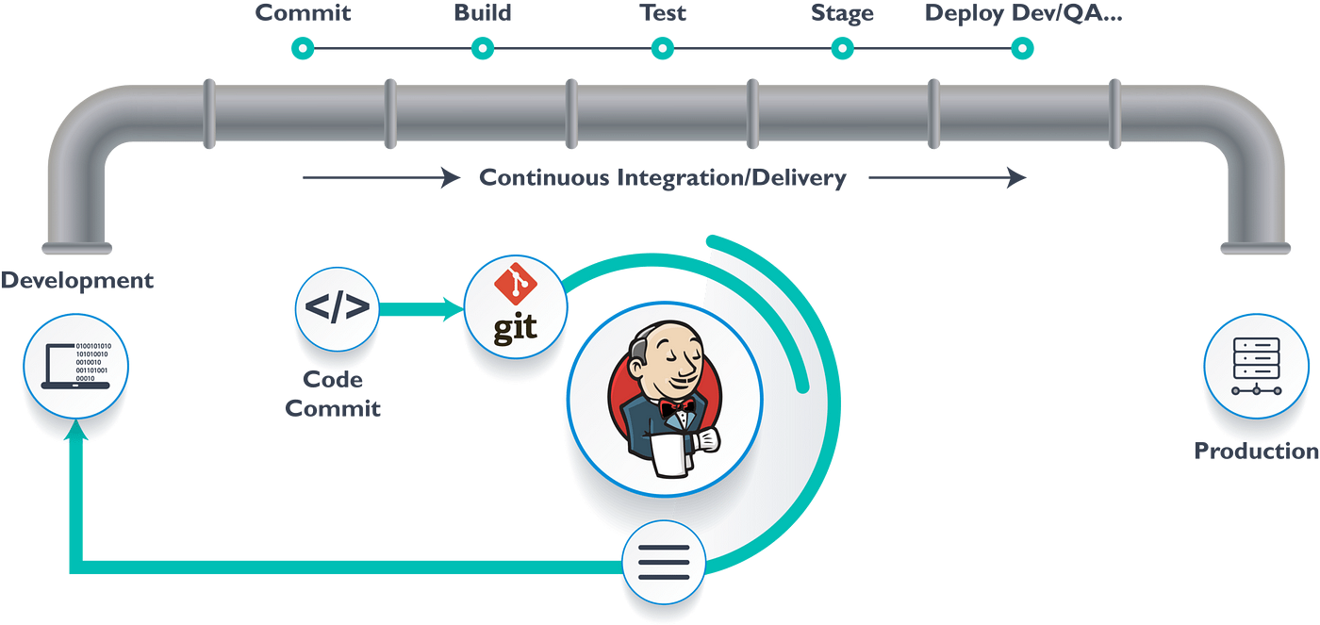
Jenkins
Jenkins is an open-source solution comprising an automation server to enable continuous integration and continuous delivery (CI/CD), automating the various stages of software development such as build, test, and deployment.

Slide 12
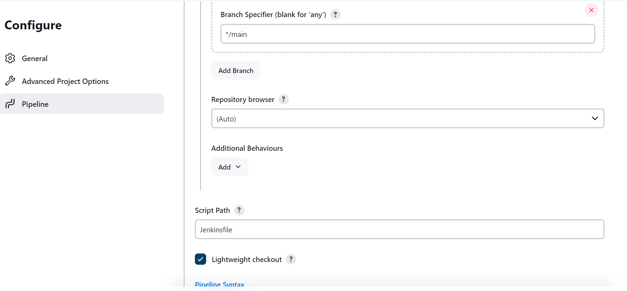
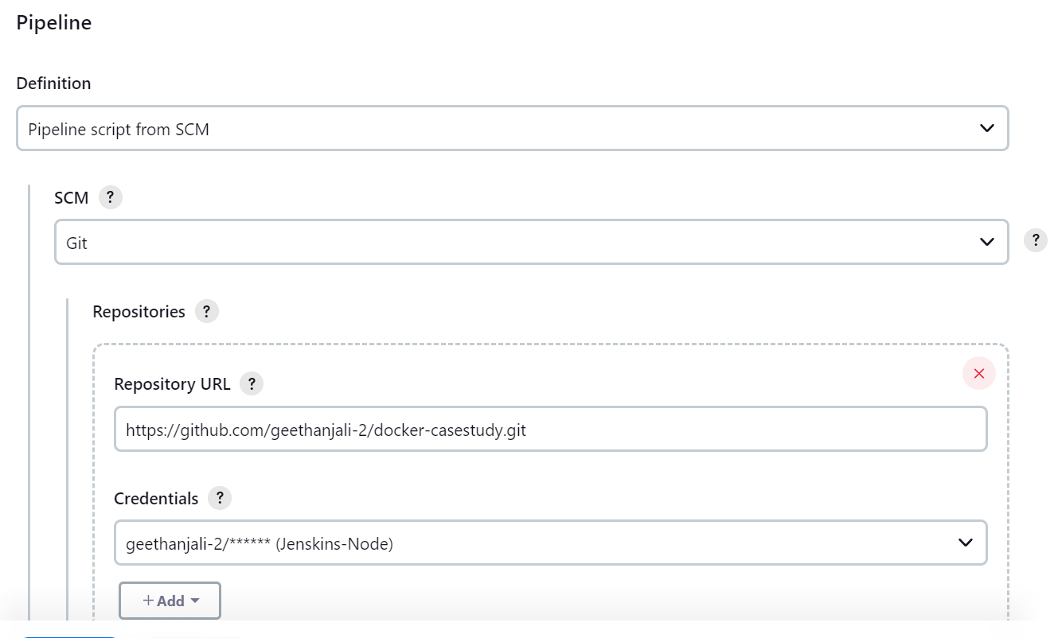
Jenkins

Slide 13
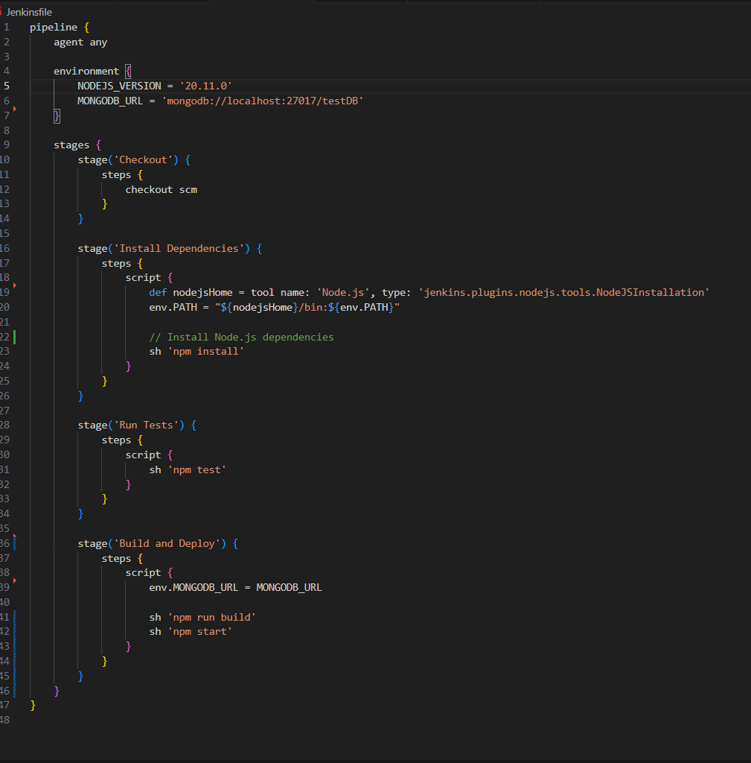
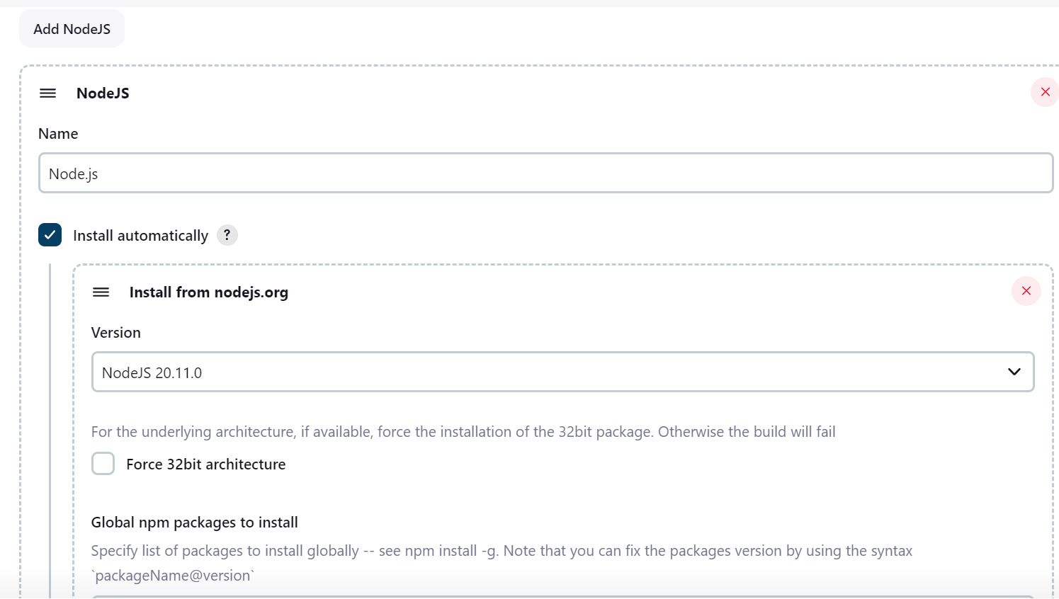
Jenkins

Slide 14
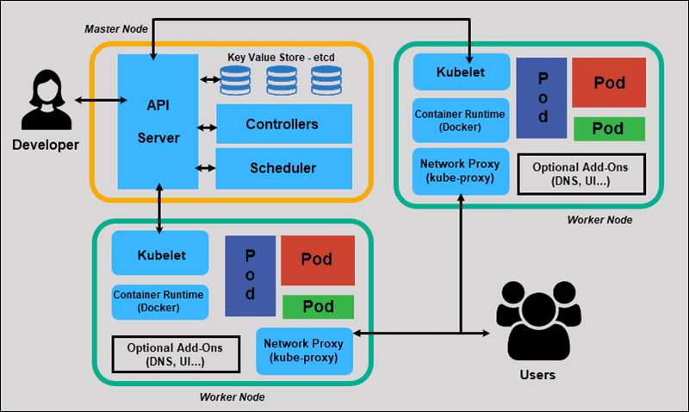
Kubernetes

Slide 15
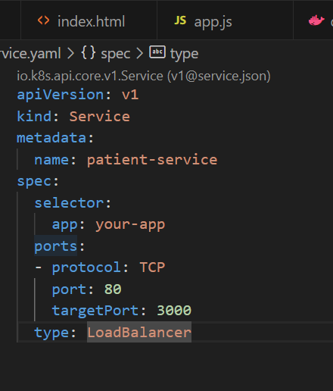
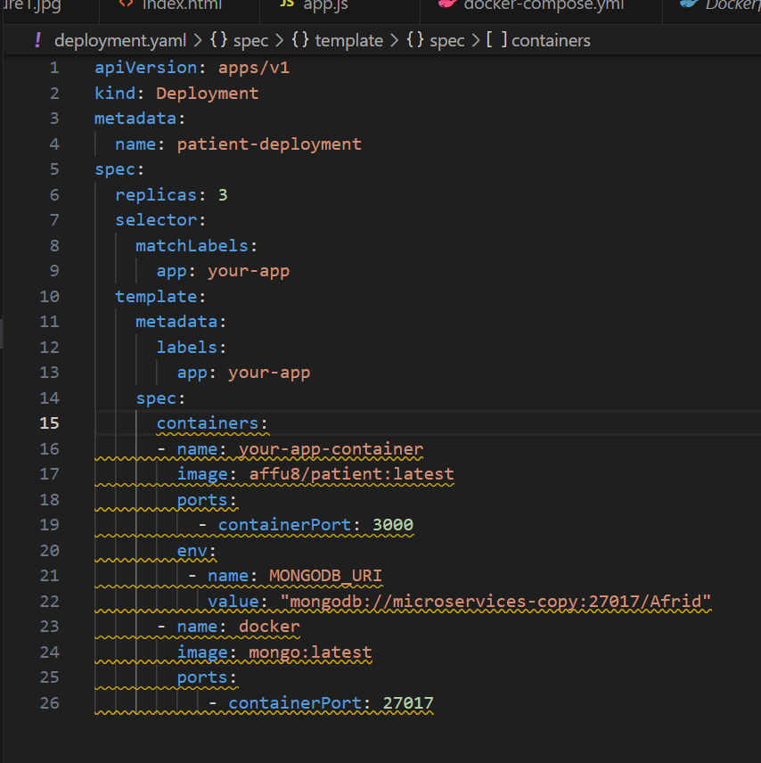
Kubernetes

Slide 16
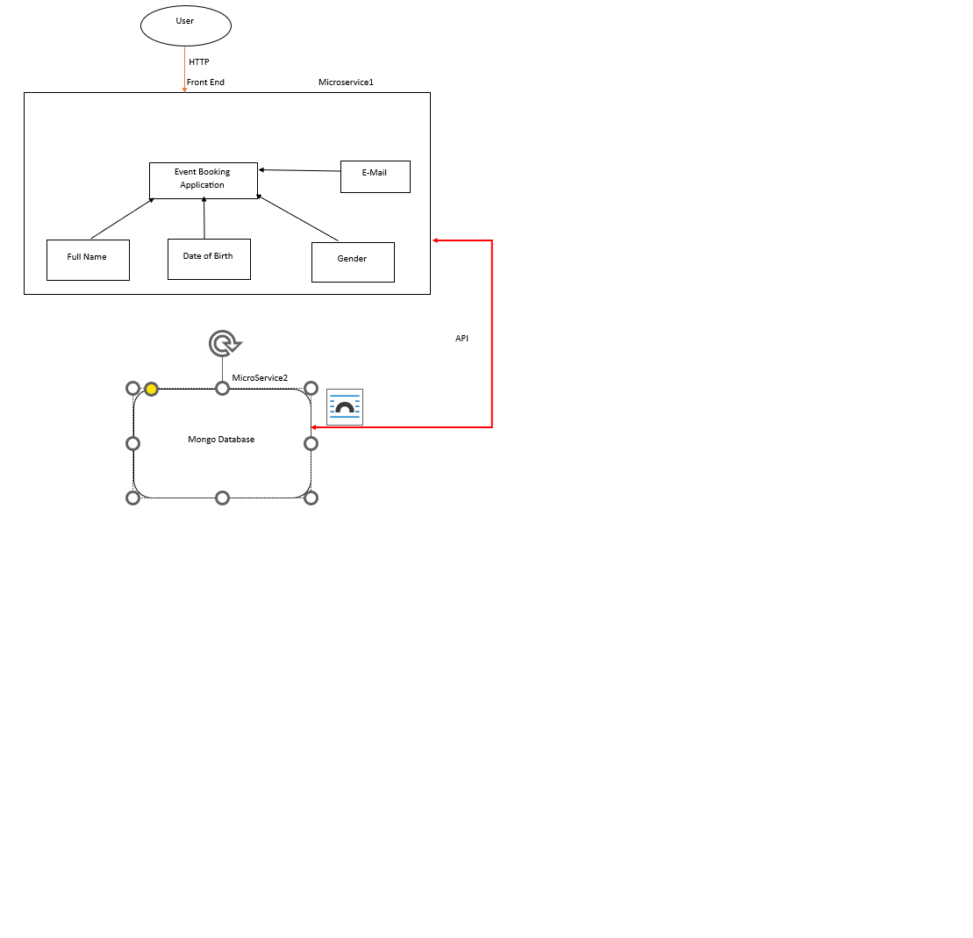
Microservice architecture

Slide 17
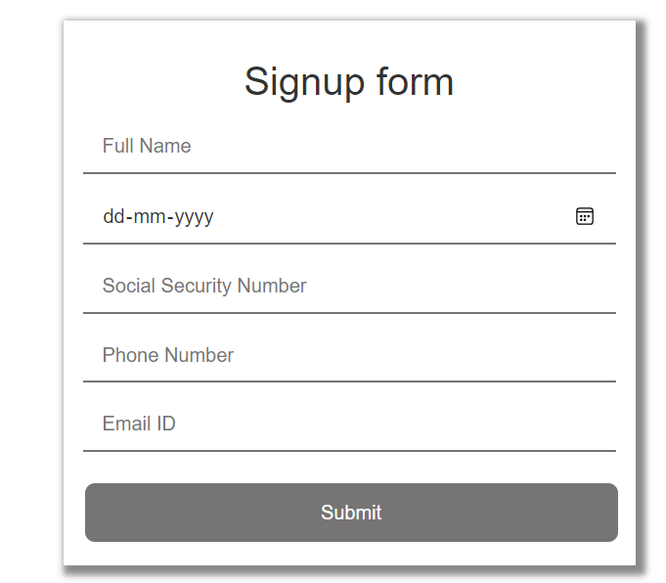
Modules:
Username
Date of Birth
Gender
SS Number
Marital Status
Phone Number
Email Id
*Delete this page before circulation
17

Slide 18
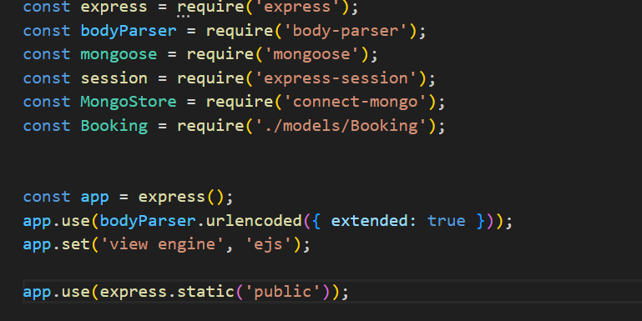
Implementation
Technologies and Libraries used
Nodejs
Express
Express-session
EJS
Body parser
MongoDB
Mongoose
Mongo Store
Connect-Mongo

Slide 19
Implementation
MongoDB
MongoDB is an open-source NoSQL database management program. NoSQL (Not only SQL) is used as an alternative to traditional relational databases.
Scalability. MongoDB supports vertical and horizontal scaling. Vertical scaling works by adding more power to an existing machine, while horizontal scaling works by adding more machines to a user's resources.
Schema-less. MongoDB is a schema-less database, which means the database can manage data without blueprint

Slide 20
Implementation
Application Structure
Models – used to define schema
node.js
Views – EJS code for rendering dynamic HTML pages
Patient Registration Form to collect details
Routes – for handling requests and route accordingly
App.js

Slide 21
Implementation
Patient Registration Form
Users can create a patient registration form by allowing users provide Full Name, Date of Birth, Gender, Social Security Number, Marital
Status, Phone Number, Email ID.To prevent duplicates booking details are saved in database with unique constraint of userId.
Then redirected to booking details after successful booking.

Slide 22
Implementation
Registration and Login Page
Users can register with their Full Name, email id, password, Social Security Number and phone number.
Users sessions are managed using express-session module

Slide 23
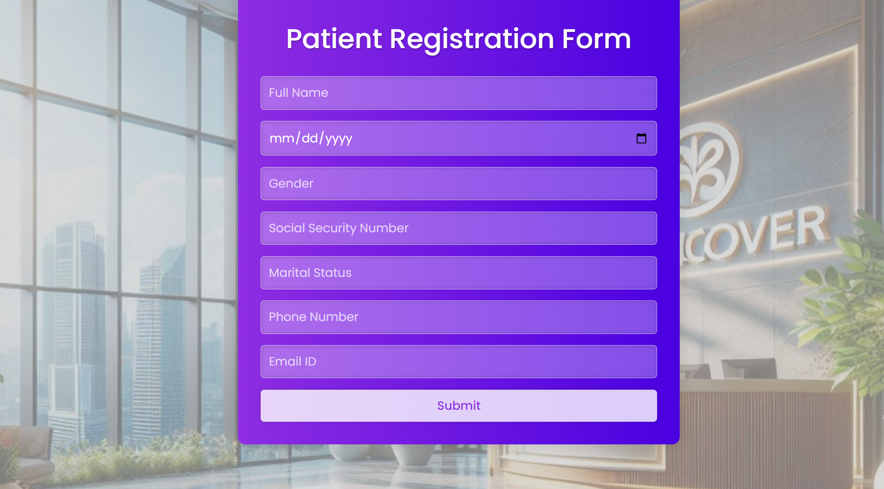
8. Screenshots

Slide 24
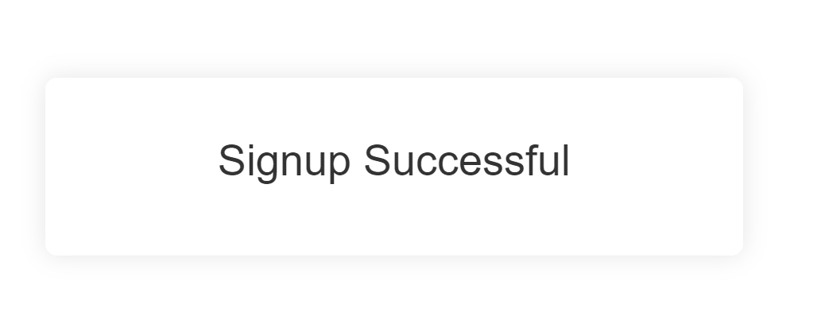
Screenshots
Screenshot of application deployed in linux environment and accessed with public ip and port number

Slide 25
thank you
copyright publicis sapient | confidential

